Slide 1


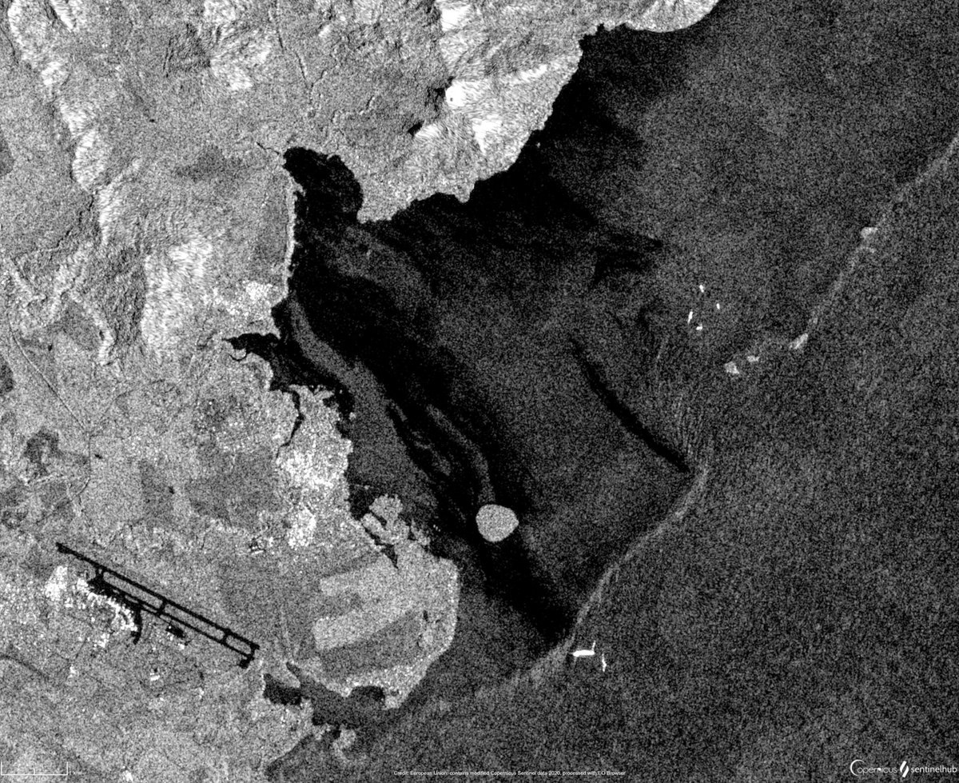

Neural Networks for
SAR Oil Spill Detection
Applied Data Science Project
Bianca Bartoli - s322799
Carlo Marra - s334220
Alessandro Valenti - s328131

Slide 2
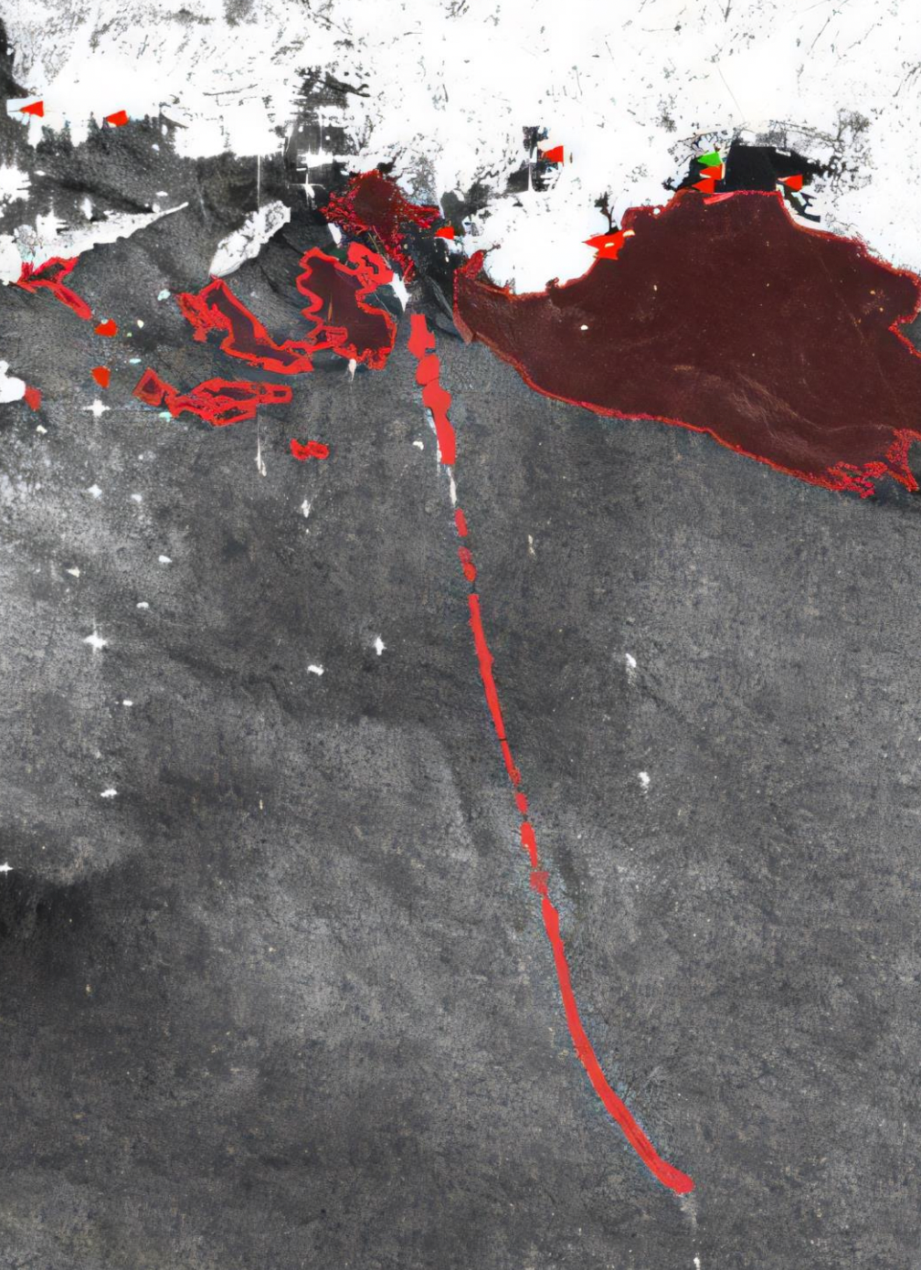
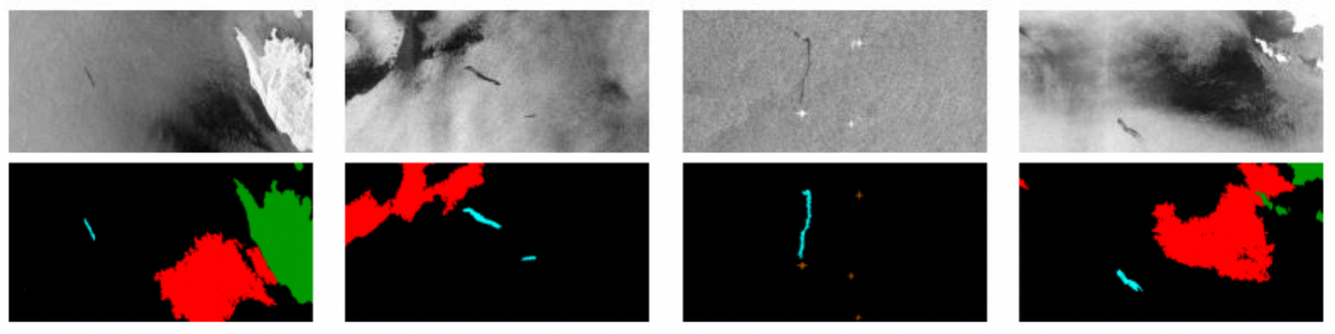
THE PROBLEM
Continuous monitoring and precise detection of oil spills are essential for mitigating their catastrophic effects
Oil spills pose a significant threat to marine ecosystems
HOW:
Segmentation of Synthetic Aperture Radar (SAR) images provided by the European Space Agency
SAR images
Segmentation mask

Slide 3



















VALUE PROPOSITION
Accurate and timely detection of oil spills is crucial for mitigating their environmental impact
Environmental Impact
Faster response times can significantly reduce the environmental damage caused by oil spills
Response Efficiency
Early detection and response help contain the spill, reducing the resources needed to manage its spread
Scalability
The developed system can be applied to any marine environment with SAR imaging availability, offering potential for global deployment

Slide 4
OBJECTIVES
OBJECTIVE 1
BENEFITS
Analyse the provided SAR images dataset
Increased Accuracy
Efficiency
OBJECTIVE 2
Advanced machine learning models provide greater accuracy than traditional methods
Reduction of time and resources for detecting and responding to oil spills
Implement and test various neural network models for segmentation tasks
OBJECTIVE 3
Evaluate each model using metrics such as Intersection over Union (IoU)
Research Contribution
Enhanced Monitoring
Contributes to AI-based environmental monitoring research using neural networks
SAR imagery enables consistent and reliable monitoring by competent authorities
OBJECTIVE 4
Deploy the selected model in a real-time monitoring system

Slide 5




STAKEHOLDERS
Public Authorities
&
Regulatory Bodies
Academic Research Institutions
Data Providers
&
Competitors
Project Sponsors
&
Partners
Environmental
Agencies
Disaster Response
&
Humanitarian Aid
International
Environmental
Agencies
National
Environmental
Agencies
International
Marine
Organization
Coastal Guard
& Marine
Protection Units

Slide 6
STAKEHOLDERS
Public Authorities
&
Regulatory Bodies
Academic Research Institutions
Data Providers
&
Competitors
Project Sponsors
&
Partners
AI Focused
Institutions
Marine & Environmental
Research Labs
Project Mentors
& Advisors
Research Personnel
involved in SS

Slide 7
STAKEHOLDERS
Public Authorities
&
Regulatory Bodies
Academic Research Institutions
Data Providers
&
Competitors
Project Sponsors
&
Partners
European Space
Agency
Commercial Funders
&
Competitors
Commercial Satellite
Imaging Companies
Similar Commercial Projects

Slide 8
STAKEHOLDERS
Public Authorities
&
Regulatory Bodies
Academic Research Institutions
Data Providers
&
Competitors
Project Sponsors
&
Partners
MARIS
Project
Consortium
Links Foundation

Slide 9

INTEREST - INFLUENCE MATRIX
High Power
Keep
Satisfied
Engaged
closely
Commercial Satellite
Imaging Companies
Project Mentors
& Advisors
Project Sponsors
&
Partners
AI Focused
Institutions
Coastal Guard
& Marine
Protection Units
Disaster Response
&
Humanitarian Aid
Low Interest
High Interest
Public Authorities
&
Regulatory Bodies
European Space
Agency
Research Personnel
involved in SS
Similar Commercial Projects
Environmental
Agencies
Keep
Informed
Monitor
Low Power

Slide 10
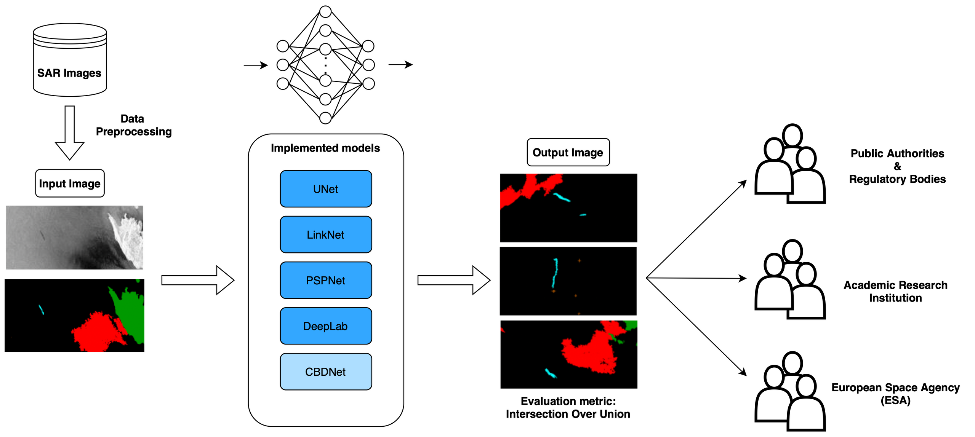
FUNCTIONAL DIAGRAM

Slide 11

USER PERSONAS
Maria
Environmental Supervisor
Pain-Points & Frustrations
Struggles with delayed or inaccurate data, which can hinder timely response to oil spill incidents
Needs & Goals
Requires accurate, real-time oil spill detection tools to support quick decision-making and minimize environmental harm
Seeks data visualization tools that simplify complex satellite data for easy interpretation by non-technical stakeholders

Slide 12
USER PERSONAS
Adam
Biomarine Researcher
Pain-Points & Frustrations
Limited access to high-quality, segmented images that precisely identify oil spill boundaries.
Difficulty in locating and assessing the impact on specific ecosystems due to vague localization of marine pollution events
Needs & Goals
Requires highly accurate segmentation data to pinpoint oil spill locations and assess ecosystem impacts.
Values precise data that enables the identification of specific habitats and species at risk, facilitating conservation efforts

Slide 13
USER PERSONAS
Thomas
ESA Project Manager
Pain-Points & Frustrations
Faces pressure to ensure data accessibility and reliability, especially for high-priority projects like oil spill detection
Needs & Goals
Needs efficient, reliable SAR data processing and distribution channels to support projects on environmental protection
Seeks partnerships to increase satellite data usage
Future Work:

Slide 14

USER STORIES
Adam, Marine Research Scientist
As a Biomarine Disaster Researcher, I want access to high-quality, segmented SAR data so that I can precisely locate oil spill boundaries and assess their impact on vulnerable marine ecosystems
Maria, Environmental Regulator
As an Environmental Regulator, I want real-time alerts on detected oil spills, so that I can initiate a rapid response to minimize environmental damage
As an Environmental Regulator, I want access to historical oil spill data, so that I can analyze trends and improve future preventative measures
As an Environmental Regulator, I want a clear visualization of oil spill locations and sizes, so that I can assess the severity and prioritize response efforts
Thomas, ESA Project Manager
As an ESA Project Manager, I want insights into how our satellite data is used by various stakeholders, so that I can demonstrate the value of ESA’s contributions
As an ESA Project Manager, I want to track the accuracy and impact of SAR-based oil spill detection, so that I can justify continued investment in similar data projects

Slide 15
WBS
WP No. | WP Title | Lead Name | PM | Start Month | End Month
1 | Project Management | B. Bartoli | 0.5 | November | November
2 | Research & Familiarization | C. Marra | 0.5 | November | November
3 | Data Exploration & Preprocessing | A. Valenti | 0.75 | November | December
4 | Model Implementation & Training | C. Marra | 2 | December | January
5 | Evaluation & Comparison | B. Bartoli | 1.25 | January | January
6 | Documentation & Communication | A. Valenti | 1 | January | January

Slide 16
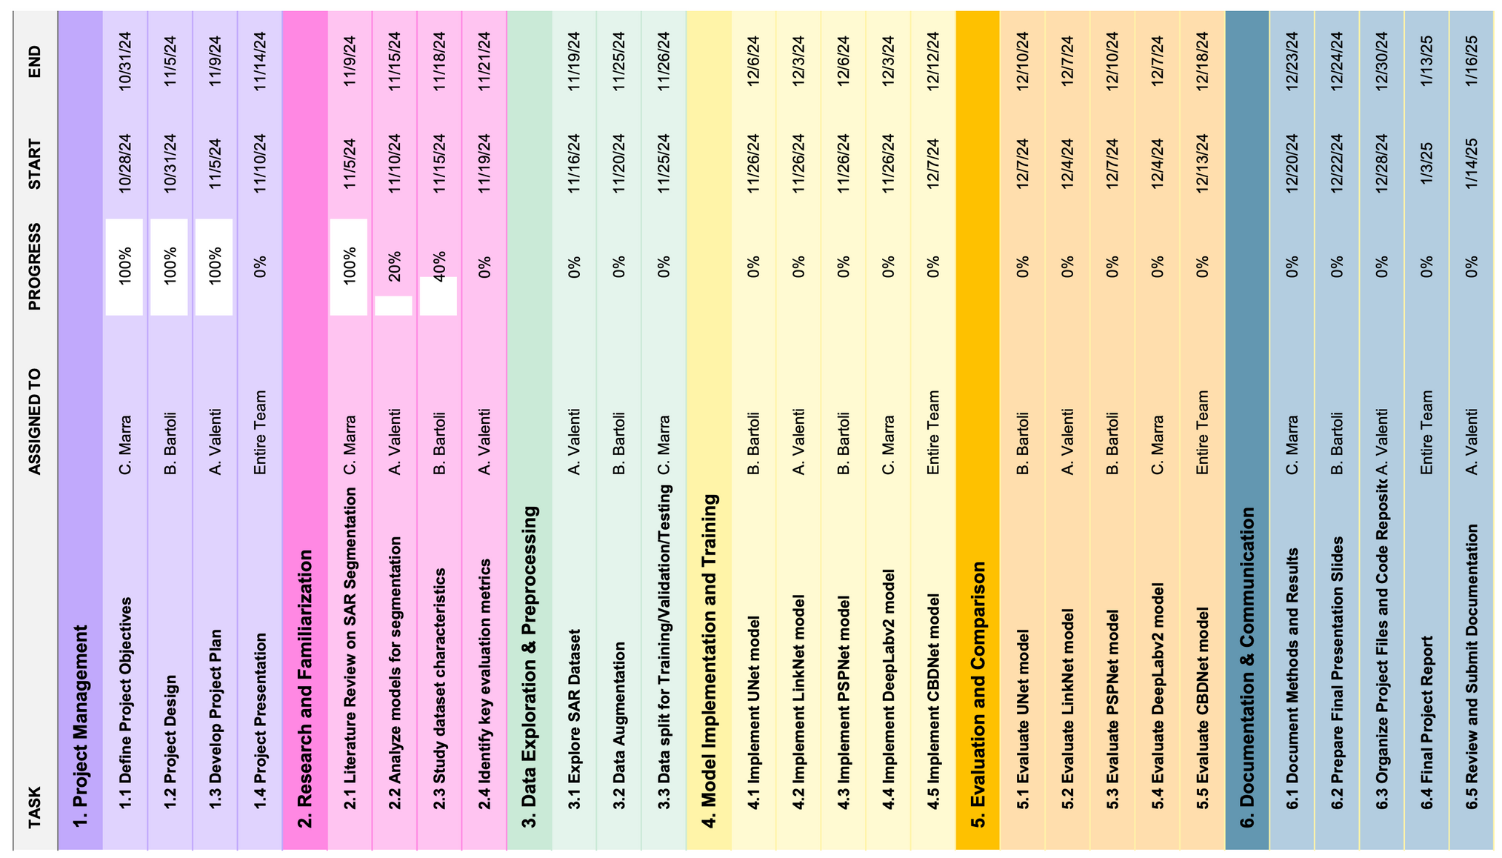
GANTT

Slide 17
GANTT (UPDATED)
October 2024
November 2024
December 2024
January 2025
Project Management
Research and Familiarization
Data Exploration & Preprocessing
Model Implementation and Training
Evaluation and Comparison
Documentation & Communication

Slide 18
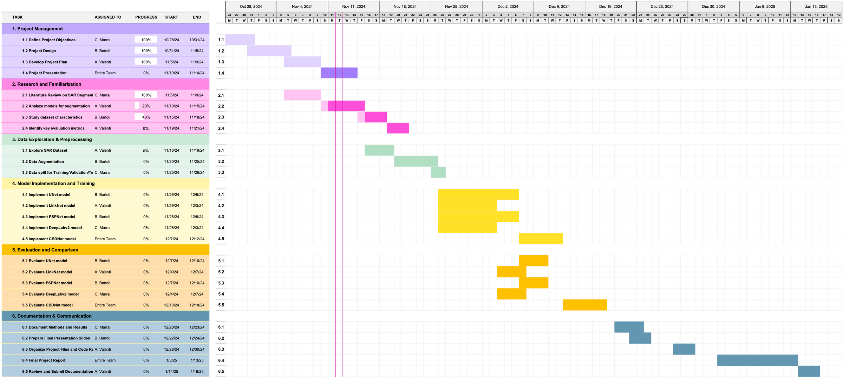

Slide 19
Thank you for your attention
Questions?
Bianca Bartoli - s322799
Carlo Marra - s334220
Alessandro Valenti - s328131

